Slide 1
Coalitional Game Theory
Edited by: Fuad Noman
Prepared by: Julian Gutierrez
School of Information Technology, Monash University Malaysia
FIT5226: Multi-Agent Systems and Collective Behaviour
10/2/2024
FIT5226-S2-2024
1/40
Notes:
Coalitional Game Theory is a branch of game theory that focuses on the analysis of cooperative games, where players (agents) form coalitions or groups to maximize their collective benefits. In coalitional games, players collaborate to achieve specific goals and distribute the gains obtained from their cooperation among themselves.
Key concepts and elements in coalitional game theory include:
Coalitions: A coalition is a group of players who work together to achieve common objectives. Coalitions can be of various sizes and compositions.
Characteristic Function: The characteristic function of a coalitional game assigns a value to each possible coalition, representing the total worth or benefit that the coalition can generate. It defines the rationality of cooperation.
Core: The core of a coalitional game contains all possible payoff allocations that are stable and satisfy certain properties. In other words, it represents a set of outcomes where no smaller coalition can obtain a better payoff by breaking away.
Shapley Value: The Shapley value is a solution concept that assigns a value to each player based on their marginal contribution to each possible coalition. It represents a fair way to distribute the total worth among the players.
Nash Bargaining Solution: This solution concept aims to find an outcome that maximizes the product of the players' gains and is a solution to a bargaining problem.
Cooperative Game Theory vs. Non-cooperative Game Theory: Cooperative game theory focuses on how players can form coalitions and cooperate to achieve mutual benefits, while non-cooperative game theory (e.g., Nash equilibrium) emphasizes self-interested decision-making without formal cooperation.
Applications: Coalitional game theory has applications in various fields, including economics, political science, and computer science. It is used to analyze scenarios where cooperation and coordination among multiple agents are essential, such as in coalition formation, resource allocation, and cost sharing.
Overall, coalitional game theory provides a framework for understanding and modeling cooperation among rational agents and offers solutions to problems where cooperation is a fundamental element. It helps to address questions of fairness, stability, and efficiency in cooperative settings.

Slide 2
Coalitional games
In a non-cooperative game:
Players are self-interested agents
Players choose their own actions
Payoffs are allocated to individual players
In a coalitional game:
Players still are self-interested agents, but ...
Players form coalitions (groups of players), which take actions
Payoffs are allocated to coalitions rather than to single players
10/2/2024
FIT5226-S2-2024
2/40
Notes:
In coalitional games, the focus shifts from individual players to groups (coalitions) of players working together to achieve common objectives. These games are characterized by cooperation, and payoffs are typically assigned to entire coalitions rather than to individual players. Here's a bit more detail about coalitional games:
Characteristics of Coalitional Games:
Cooperative Nature: Coalitional games are inherently cooperative, as players collaborate within coalitions to maximize their joint payoffs.
Coalition Formation: Players can form various coalitions, and the challenge often lies in determining which coalitions are stable and lead to equitable outcomes.
Transferable Utility: Coalitional games assume that utility or payoff is transferable among coalition members. This means that players within a coalition can distribute their collective payoff among themselves in any way they see fit.
Characteristic Function:
The characteristic function is a fundamental concept in coalitional games. It assigns a value to each possible coalition, representing the worth or benefit that the coalition can achieve. In other words, it quantifies the total gain achievable when a particular group of players cooperates.
Core and Stable Outcomes:
One of the central goals in coalitional game theory is to identify the core, which is a set of outcomes where no smaller coalition can obtain a better payoff by breaking away. The core contains outcomes that are considered stable, ensuring that no group of players has an incentive to leave the coalition.
Solution Concepts:
Various solution concepts are used in coalitional games to distribute the coalition's total worth among its members fairly. Some well-known solution concepts include the Shapley value and the nucleolus.
Applications:
Coalitional game theory finds applications in fields such as economics, political science, and cooperative robotics. It is used to study scenarios involving cooperation, cost sharing, coalition formation, and resource allocation.
Comparison to Non-Cooperative Games:
In non-cooperative games, players act independently in their own self-interest, often resulting in Nash equilibria. In contrast, coalitional games focus on group dynamics, where players deliberately form alliances to maximize collective gains.
In summary, coalitional games provide a framework for analyzing and understanding cooperative behavior among rational agents. They are particularly useful in situations where players can achieve more by working together, and the challenge is to distribute the benefits fairly among the cooperating parties.

Slide 3
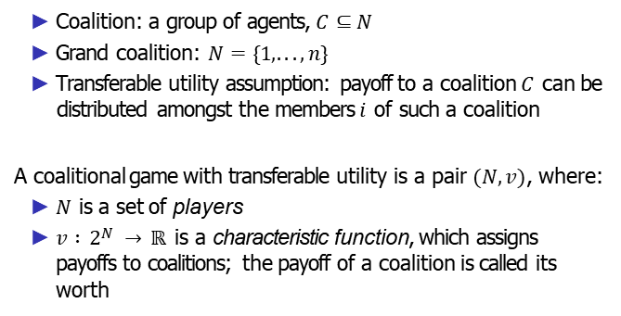
Coalitional games with transferable utility
Coalition: a group of agents, $C⊆N$
Grand coalition: $N=\{1, . . . , n\}$
Transferable utility assumption: payoff to a coalition $C$ can be distributed amongst the members $i$ of such a coalition
A coalitional game with transferable utility is a pair $(N, v )$, where:
$N$ is a set of players
$v : 2N → ℝ$is a characteristic function, which assigns payoffs to coalitions; the payoff of a coalition is called its worth
"$2^{N}$" refers to the collection of all possible coalitions that can be formed by selecting various subsets of the player set 𝑁.
10/2/2024
FIT5226-S2-2024
3/40
Notes:
In these games, the focus is on how a coalition of players (agents) can work together to achieve collective objectives while fairly distributing the benefits among its members. Here's a bit more detail on the key concepts:
Coalition and Grand Coalition:
A coalition, denoted as 𝐶, is a group of agents or players selected from the set 𝑁. In other words, it's a subset of the entire player set.
The grand coalition represents the entire set of players, 𝑁={1, . . . , 𝑛}. It includes all players in the game.
Transferable Utility Assumption:
One of the defining characteristics of these games is the transferable utility assumption. This assumption allows the payoff (utility) generated by a coalition to be distributed among its members in any way they choose.
In essence, players within a coalition can negotiate and agree on how to distribute the benefits they collectively earn. This transferability makes it feasible for players to cooperate, as they can ensure they receive a fair share of the rewards.
Characteristic Function:
The characteristic function 𝑣 : $2^{N}$→ ℝ is a fundamental component of coalitional games with transferable utility. It assigns a real number (the worth or value) to every possible coalition formed by the players.
The characteristic function quantifies the benefit or value that a coalition can achieve by working together.
Shapley Value:
The Shapley value is a widely used solution concept in these games. It assigns a fair distribution of the total worth to each player, considering all possible orders in which players could join a coalition. It ensures that each player's contribution to the coalition is properly recognized and rewarded.
Applications:
Coalitional games with transferable utility are commonly applied in cooperative scenarios in various fields, such as economics (e.g., cost-sharing in cooperative production), operations research (e.g., resource allocation in project management), and political science (e.g., coalition formation in voting systems).
In summary, coalitional games with transferable utility provide a framework for modeling and analyzing cooperative behavior, where groups of players can form coalitions to maximize their collective gains. The transferable utility assumption allows for fair and flexible distribution of rewards, fostering collaboration among rational agents. The characteristic function plays a central role in assessing the value of different coalitions and guiding the allocation of benefits.

Slide 4
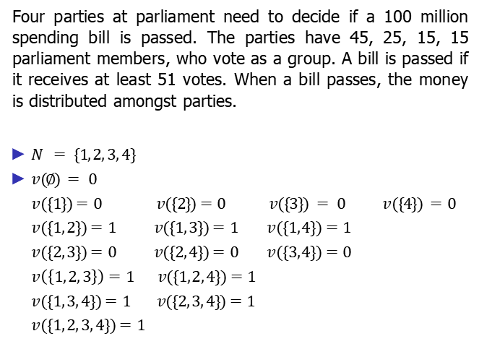
Example: Social choice – Voting game
Four parties at parliament need to decide if a 100 million spending bill is passed. The parties have 45, 25, 15, 15 parliament members, who vote as a group. A bill is passed if it receives at least 51 votes. When a bill passes, the money is distributed amongst parties.
$N = \{1, 2, 3, 4\}$
$v (∅) = 0$
$v (\{1\})=0 v (\{2\})=0 v (\{3\}) = 0 v (\{4\}) =0$
$v (\{1, 2\})=1 v (\{1, 3\})=1 v (\{1, 4\})=1$
$v (\{2, 3\})=0 v (\{2, 4\})=0 v (\{3, 4\})=0$
$v \left(\left\{1, 2, 3\right\}\right)=1 v (\{1, 2, 4\})=1$
$v (\{1, 3, 4\})=1 v (\{2, 3, 4\})=1$
$v (\{1, 2, 3, 4\})=1$
10/2/2024
FIT5226-S2-2024
4/40
Notes:
In this example of a social choice or voting game, four political parties in a parliament are deciding the fate of a 100 million spending bill. Each party is represented by the number of parliament members they have, and they vote as a group. The bill requires at least 51 votes to pass, and when it does pass, the money is distributed among the parties. The characteristic function 𝑣 describes the worth or value of different coalitions.
Here's the breakdown of the coalitions and their associated values:
𝑣(∅) = 0: The empty coalition has no voting power or worth.
𝑣({1}) = 0, 𝑣({2}) = 0, 𝑣({3}) = 0, 𝑣({4}) = 0: Individual parties have no power on their own; they cannot pass the bill.
𝑣({1, 2}) = 1, 𝑣({1, 3}) = 1, 𝑣({1, 4}) = 1: When party 1 forms a coalition with any other party, they have the power to pass the bill. In this case, the value is 1.
𝑣({2, 3}) = 0, 𝑣({2, 4}) = 0, 𝑣({3, 4}) = 0: Parties 2, 3, and 4, when forming coalitions among themselves, do not have enough votes to pass the bill.
𝑣({1, 2, 3}) = 1, 𝑣({1, 2, 4}) = 1: Coalitions including party 1 and any combination of two other parties are able to pass the bill.
𝑣({1, 3, 4}) = 1, 𝑣({2, 3, 4}) = 1: Similar to the previous case, coalitions including party 1 along with two other parties have the power to pass the bill.
𝑣({1, 2, 3, 4}) = 1: The grand coalition, including all four parties, has the power to pass the bill.
This characteristic function represents the distribution of power among different coalitions and is essential for understanding how the parties can cooperate to pass the spending bill. In this specific example, it shows that party 1 holds the swing vote, as any coalition involving party 1 has the power to decide the bill's fate. This example illustrates the dynamics of cooperative decision-making in a political context.

Slide 5
Main problems/questions
Which coalitions will form? (A question about stability)
How should coalitions’ payoffs be divided amongst members? (A question about fair distribution)
10/2/2024
FIT5226-S2-2024
5/40
Notes:
In the context of coalitional games with transferable utility, there are two main problems or questions that arise:
Coalition Formation (Stability):
Which Coalitions Will Form? This is a question about the stability of coalitions. In a group of self-interested agents, the challenge is to determine which coalitions will be stable and enduring. Stability in this context means that no subset of agents within a coalition has an incentive to break away and form a new coalition. The study of coalition formation seeks to understand how rational agents cooperate and the conditions under which coalitions are likely to form and persist. Various cooperative game theory solutions, like the core or the Shapley value, provide insights into stable coalition formation.
Payoff Division (Fair Distribution):
How Should Coalitions' Payoffs Be Divided Amongst Members? Once coalitions are formed and achieve a certain worth, the question of how to fairly distribute the payoffs among their members arises. This is a question about fair distribution. Cooperative game theory aims to address this issue by proposing different methods to distribute the value generated by a coalition among its members in a fair and rational way. Classical solutions include the Shapley value, the nucleolus, and other allocation rules, each with its own definition of fairness and properties.
These problems are central to understanding cooperative behavior among self-interested agents in various domains, including economics, political science, and multi-agent systems. Solutions to these problems help ensure that cooperation is stable and that the benefits are distributed fairly among the participants. The choice of solution concept often depends on the specific context and the fairness criteria that are considered most appropriate.

Slide 6
Classes of coalitional games
Superadditive
Additive
Constant-sum
Convex
Simple
10/2/2024
FIT5226-S2-2024
6/40
Notes:
Coalitional games are categorized into different classes based on the properties of their characteristic functions and the nature of cooperation among agents. Here are the five main classes of coalitional games:
Superadditive Games:
In a superadditive game, the worth of a coalition is greater than or equal to the sum of the individual values of its members. Mathematically, for all coalitions C and D, if C ∩ D = ∅ (i.e., they have no members in common), then v(C ∪ D) ≥ v(C) + v(D). This property reflects situations where cooperation results in synergies, and the total value created by a coalition is greater than the sum of its parts.
Additive Games:
In an additive game, the worth of a coalition is precisely equal to the sum of the individual values of its members. Mathematically, for all coalitions C, $v(C)=\sum_{i∈C}{v(\{i\})}.$Additive games represent scenarios where cooperation does not lead to any additional value beyond the sum of individual contributions.
Constant-Sum Games:
Constant-sum games are a special case of coalitional games where the sum of payoffs remains constant, regardless of the coalition formed. In other words, the total worth of the grand coalition is always the same, and the distribution of payoffs may vary. Such games are often used to model competitive situations.
Convex Games:
Convex games are those in which the characteristic function exhibits convexity. Specifically, for all coalitions C and D, if C ⊆ D, then v(C) + v(D\C) ≤ v(D). Convexity implies that forming larger coalitions cannot lead to a decrease in total worth. These games are associated with situations where agents can cooperate in a non-diminishing manner.
Simple Games:
Simple games are characterized by a binary characteristic function, where the worth of a coalition is either 0 (if the coalition is not winning) or 1 (if it is winning). These games are often used to model situations where the goal is to determine whether a coalition can achieve its objectives or not. Simple games have applications in voting theory and cooperative decision-making.
Each class of coalitional games provides a different framework for modeling and analyzing cooperation, and various solution concepts have been developed to address the questions of stability and fair payoff distribution within each class. These solution concepts, such as the core, Shapley value, and nucleolus, help capture different aspects of cooperative behavior and can be applied to specific classes of coalitional games.

Slide 7
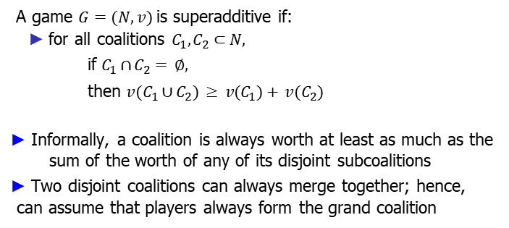
Superadditive games
A game $G=(N, v )$is superadditive if:
for all coalitions $C_{1}, C_{2}⊂N,$ if $C_{1}∩ C_{2}= ∅,$
then $v (C_{1}∪ C_{2}) ≥ v (C_{1})+ v (C_{2})$
Informally, a coalition is always worth at least as much as the sum of the worth of any of its disjoint subcoalitions
Two disjoint coalitions can always merge together; hence, can assume that players always form the grand coalition
No member belongs to both coalitions
10/2/2024
FIT5226-S2-2024
7/40
Notes:
Superadditive games are characterized by their cooperative nature, where forming larger coalitions results in at least as much value as the sum of the values of their individual parts. Here's what it means:
Definition: A game 𝐺 = (𝑁, 𝑣) is superadditive if, for all coalitions 𝐶₁ and 𝐶₂ ⊆ 𝑁 (the set of players), such that 𝐶₁ ∩ 𝐶₂ = ∅ (i.e., they have no members in common), the worth of the union of these coalitions is greater than or equal to the sum of the worth of the individual coalitions. Symbolically, if 𝐶₁ ∩ 𝐶₂ = ∅, then 𝑣(𝐶₁ ∪ 𝐶₂) ≥ 𝑣(𝐶₁) + 𝑣(𝐶₂).
Informal Interpretation: In superadditive games, the principle is that cooperation is beneficial. When two disjoint coalitions come together to form a larger coalition, the value created by the larger coalition should be at least as much as the sum of the values of the smaller coalitions. This implies that players have an incentive to join forces and cooperate, as it increases the overall value.
Merging to the Grand Coalition: Due to the superadditive property, it's always advantageous for players to merge into the grand coalition (the entire set of players, 𝑁). This is because the worth of the grand coalition is guaranteed to be at least as high as the sum of the worth of any combination of disjoint subcoalitions. As a result, in superadditive games, it is often assumed that players will cooperate and form the grand coalition to maximize their collective payoff.
Superadditive games are commonly used to model cooperative situations where collaboration and the formation of larger groups lead to increased value, such as in joint ventures, production processes, or research efforts. This property makes them suitable for analyzing scenarios where cooperation is inherently advantageous, and players have a strong incentive to work together.

Slide 8
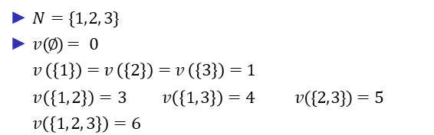
Example: Superadditive games
$N=\{1, 2, 3\}$
$v (∅)= 0$
$v \left(\left\{1\right\}\right)=v \left(\left\{2\right\}\right)=v \left(\left\{3\right\}\right)=1$
$$v \left(\left\{1, 2\right\}\right)=3 v \left(\left\{1, 3\right\}\right)=4 v (\{2, 3\})=5$$
$v\left(\left\{1, 2, 3\right\}\right)=6$
Grand Coalition
10/2/2024
FIT5226-S2-2024
8/40
Notes:
Analyzing the example of a superadditive game with the given characteristic function:
- Players: 𝑁 = {1, 2, 3}
- Characteristic function 𝑣(𝐶), representing the worth of coalitions:
𝑣(∅) = 0
𝑣({1}) = 𝑣({2}) = 𝑣({3}) = 1
𝑣({1, 2}) = 3
𝑣({1, 3}) = 4
𝑣({2, 3}) = 5
𝑣({1, 2, 3}) = 6
Now, let's check if this game is superadditive by verifying that the worth of the union of disjoint coalitions is always greater than or equal to the sum of their individual worth.
Consider coalitions 𝐶₁ = {1} and 𝐶₂ = {2}. They are disjoint, and their union is {1, 2}. Does the superadditive condition hold?
𝑣({1, 2}) = 3
𝑣({1}) + 𝑣({2}) = 1 + 1 = 2
Since 𝑣({1, 2}) ≥ 𝑣({1}) + 𝑣({2}), the condition holds.
Consider coalitions 𝐶₁ = {1, 2} and 𝐶₂ = {3}. They are disjoint, and their union is {1, 2, 3}. Does the superadditive condition hold?
𝑣({1, 2, 3}) = 6
𝑣({1, 2}) + 𝑣({3}) = 3 + 1 = 4
Again, 𝑣({1, 2, 3}) ≥ 𝑣({1, 2}) + 𝑣({3}), so the condition holds.
Consider coalitions 𝐶₁ = {1} and 𝐶₂ = {2, 3}. They are disjoint, and their union is {1, 2, 3}. Does the superadditive condition hold?
𝑣({1, 2, 3}) = 6
𝑣({1}) + 𝑣({2, 3}) = 1 + 5 = 6
Once again, 𝑣({1, 2, 3}) ≥ 𝑣({1}) + 𝑣({2, 3}), so the condition holds.
Since the superadditive condition is satisfied for all possible combinations of disjoint coalitions, we can conclude that this game is indeed superadditive. Players are incentivized to cooperate and form the grand coalition {1, 2, 3} to maximize their total worth, as doing so always results in a worth at least as high as the sum of the worth of any smaller coalitions.

Slide 9
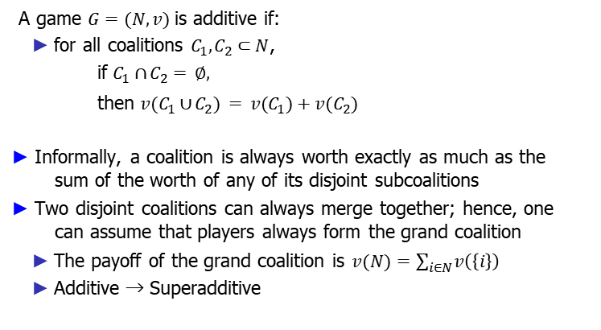
Additive games
A game $G=(N, v )$is additive if:
for all coalitions $C_{1}, C_{2}⊂N$, if $C_{1}∩ C_{2}= ∅,$
then $v (C_{1}∪ C_{2}) = v (C_{1})+v (C_{2})$
Informally, a coalition is always worth exactly as much as the sum of the worth of any of its disjoint subcoalitions
Two disjoint coalitions can always merge together; hence, one can assume that players always form the grand coalition
The payoff of the grand coalition is $v (N)=\sum_{i∈N}{v\left(\left\{i\right\}\right)}$
Additive → Superadditive
10/2/2024
FIT5226-S2-2024
9/40
Notes:
In an additive game, the worth of a coalition is exactly equal to the sum of the worth of its disjoint subcoalitions. This means that players have a strong incentive to form the grand coalition, as the worth of the grand coalition is the sum of the individual players' worth.
Mathematically, a game 𝐺=(𝑁, 𝑣 ) is additive if the following condition holds for all coalitions 𝐶₁ and 𝐶₂:
If 𝐶₁∩ 𝐶₂= ∅, then 𝑣 (𝐶₁∪ 𝐶₂) = 𝑣 (𝐶₁) + 𝑣 (𝐶₂)
This condition implies that no matter how you partition the grand coalition into disjoint subcoalitions, the worth of the grand coalition remains consistent, which encourages players to collaborate.
The worth of the grand coalition, denoted as 𝑣 (𝑁), is the sum of the worth of all individual players in the game:
$v (N)=\sum_{i∈N}{v\left(\left\{i\right\}\right)}$
Additive games are a special case of superadditive games, as in a superadditive game, the worth of a coalition is at least as much as the sum of the worth of its disjoint subcoalitions, while in an additive game, it's exactly equal. Both types of games encourage players to merge into the grand coalition, ensuring cooperation among players.

Slide 10

Example: Additive games
$N=\{1, 2, 3\}$
$v (∅)=0$
$v \left(\left\{1\right\}\right)=v \left(\left\{2\right\}\right)=v \left(\left\{3\right\}\right)=1$
$$v \left(\left\{1, 2\right\}\right)=2 v \left(\left\{1, 3\right\}\right)=2 v \left(\left\{2, 3\right\}\right)= 2$$
$v \left(\left\{1, 2, 3\right\}\right)=3$
10/2/2024
FIT5226-S2-2024
10/40
Notes:
In an additive game, the worth of a coalition is equal to the sum of the worth of its individual members. Additive games promote cooperation and coalition formation, where the value of a coalition is precisely the sum of the values of its members.
Here's an example of an additive game:
Players: 𝑁 = {1, 2, 3}
Characteristic function 𝑣:
𝑣 (∅) = 0
𝑣 ({1}) = 𝑣 ({2}) = 𝑣 ({3}) = 1
𝑣 ({1, 2}) = 2
𝑣 ({1, 3}) = 2
𝑣 ({2, 3}) = 2
𝑣 ({1, 2, 3}) = 3
In this example, the worth of each individual player is 1. When players form coalitions, the worth of the coalition is simply the sum of the individual players' values. For instance, 𝑣 ({1, 2}) is 2 because the coalition's worth is the sum of the values of player 1 and player 2 (1 + 1 = 2). Similarly, the worth of the grand coalition ({1, 2, 3}) is 3, which is the sum of the values of all three players (1 + 1 + 1 = 3). This example demonstrates the additive nature of the game, where coalition worth is additive, and the total worth of the grand coalition is the sum of individual player values.

Slide 11
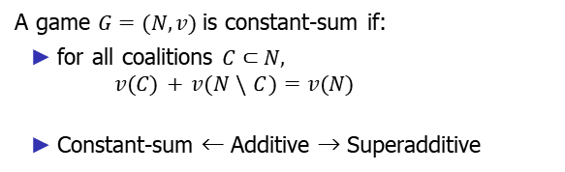
Constant-sum games
A game $G=(N, v )$is constant-sum if:
for all coalitions $C⊂N,$
$$v (C ) + v (N \backslash C )=v (N)$$
Constant-sum ← Additive → Superadditive
10/2/2024
FIT5226-S2-2024
11/40
Notes:
In a constant-sum game, the worth of any coalition plus the worth of its complement (the set of players not in the coalition) is always equal to the worth of the grand coalition. This means that the total worth of the entire set of players remains constant, regardless of how they are grouped into different coalitions.
Mathematically, a game 𝐺=(𝑁, 𝑣 ) is constant-sum if the following condition holds for all coalitions 𝐶:
𝑣 (𝐶 ) + 𝑣 (𝑁 \ 𝐶 ) = 𝑣 (𝑁)
This condition implies that the worth of any coalition, when added to the worth of its complement, is equal to the worth of the entire set of players. Constant-sum games are a special case of additive games.
The relationship between these types of games is as follows:
Constant-sum games are a subset of additive games, as they satisfy the additive condition.
Additive games, in turn, are a subset of superadditive games, as they satisfy the superadditive condition.
Constant-sum games are a particular class of coalitional games where the total value remains constant, promoting cooperation and coalition formation among players.

Slide 12
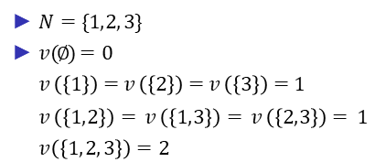
Example: Constant-sum games
$N=\{1, 2, 3\}$
$v (∅)=0$
$v \left(\left\{1\right\}\right)=v \left(\left\{2\right\}\right)=v \left(\left\{3\right\}\right)=1$
$$v \left(\left\{1, 2\right\}\right)= v \left(\left\{1, 3\right\}\right)= v \left(\left\{2, 3\right\}\right)= 1$$
$v \left(\left\{1, 2, 3\right\}\right)=2$
10/2/2024
FIT5226-S2-2024
12/40
Notes:
In a constant-sum game, the worth of a coalition is such that the sum of its worth and the worth of its complement in the grand coalition is a constant value. These games are also known as zero-sum games, as the total worth of the grand coalition remains fixed.
Here's an example of a constant-sum game:
Players: 𝑁 = {1, 2, 3}
Characteristic function 𝑣:
𝑣 (∅) = 0
𝑣 ({1}) = 𝑣 ({2}) = 𝑣 ({3}) = 1
𝑣 ({1, 2}) = 𝑣 ({1, 3}) = 𝑣 ({2, 3}) = 1
𝑣 ({1, 2, 3}) = 2
In this example, the worth of each individual player is 1. When players form coalitions, the characteristic function ensures that the sum of the coalition's worth and the complement's worth in the grand coalition remains constant. For instance, 𝑣 ({1, 2}) = 1, and the complement of this coalition ({3}) also has a worth of 1, so the sum remains constant at 1. Similarly, 𝑣 ({1, 2, 3}) = 2, and the worth of the complement ({}) is 0, making the sum also equal to 2.
Constant-sum games have applications in various fields, including competitive games and economics, where one player's gain is matched by another player's loss. These games are important for understanding strategic interactions and finding optimal solutions in zero-sum situations.

Slide 13
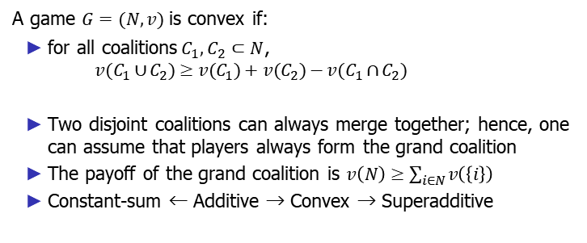
Convex games
A game $G=(N, v )$is convex if:
for all coalitions$C_{1}, C_{2}⊂N$,
$$v (C_{1}∪ C_{2})≥v (C_{1})+v (C_{2})−v (C_{1}∩ C_{2})$$
Two disjoint coalitions can always merge together; hence, one can assume that players always form the grand coalition
The payoff of the grand coalition is $v \left(N\right)≥\sum_{i∈N}{v\left(\left\{i\right\}\right)}$
Constant-sum ← Additive → Convex → Superadditive
10/2/2024
FIT5226-S2-2024
13/40
Notes:
Convex games are a type of coalitional game where the characteristic function exhibits a specific property. In convex games, the worth of a coalition formed by merging two disjoint coalitions is greater than or equal to the sum of the worth of those two disjoint coalitions, minus the worth of their intersection.
Mathematically, a game 𝐺=(𝑁, 𝑣) is considered convex if, for all coalitions $C_{1}, C_{2}⊂N$:
$v(C_{1}∪C_{2}) ≥ v(C_{1}) + v(C_{2}) − v(C_{1}∩C_{2})$
The concept of convex games implies that two disjoint coalitions can always merge together to form a larger coalition, and the payoff of this merged coalition is at least as much as the sum of the payoffs of the individual coalitions minus the worth of their intersection.
Convex games have applications in cooperative game theory, economics, and other fields where agents cooperate in various combinations. The property of convexity simplifies the analysis of cooperative behavior, as it ensures that the grand coalition (all players) can achieve at least the sum of what individual disjoint coalitions could achieve.
Convex games are part of a hierarchy of coalitional games, with constant-sum games and additive games being special cases of convex games. Superadditive games are a broader class that includes both convex and additive games. Understanding the properties of these games is essential for studying cooperative behavior, power allocation, and resource distribution among agents.

Slide 14

Example: Convex games
$N=\{1, 2, 3\}$
$v \left(∅\right)=0$
$v \left(\left\{1\right\}\right)=v \left(\left\{2\right\}\right)=v \left(\left\{3\right\}\right)=1$
$v \left(\left\{1, 2\right\}\right)=3 v \left(\left\{1, 3\right\}\right)=4 v (\{2, 3\})=5$
$v (\{1, 2, 3\})=8$
10/2/2024
FIT5226-S2-2024
14/40
Notes:
Certainly, here's an example of a convex game:
Consider a set of players 𝑁={1, 2, 3}, and their characteristic function 𝑣:
𝑣(∅) = 0 (The empty coalition has a worth of 0)
𝑣({1}) = 𝑣({2}) = 𝑣({3}) = 1 (Each individual player has a worth of 1)
𝑣({1, 2}) = 3 (The coalition {1, 2} has a worth of 3)
𝑣({1, 3}) = 4 (The coalition {1, 3} has a worth of 4)
𝑣({2, 3}) = 5 (The coalition {2, 3} has a worth of 5)
𝑣({1, 2, 3}) = 8 (The grand coalition {1, 2, 3} has a worth of 8)
Now, let's check if this game is convex:
For all coalitions $C_{1}$and $C_{2}⊂N$such that $C_{1}∩C_{2}=∅$:
For $C_{1}=\{1$} and $C_{2}=\{2\}:$
$v(C_{1}∪C_{2}) = v(\{1, 2\}) = 3$
$v(C_{1}) + v(C_{2}) − v(C_{1}∩C_{2}) = v(\{1\}) + v(\{2\}) − v(∅) = 1 + 1 − 0 = 2$
Since $v(C_{1}∪C_{2}) ≥ v(C_{1}) + v(C_{2}) − v(C_{1}∩C_{2}),$the game is convex for this pair of coalitions.
For $C_{1}=\{1, 3\}$and $C_{2}=\{2\}:$
$v(C_{1}∪C_{2}) = v(\{1, 3, 2\}) = 8$
$v(C_{1}) + v(C_{2}) − v(C_{1}∩C_{2}) = v(\{1, 3\}) + v(\{2\}) − v(∅) = 4 + 1 − 0 = 5$
Since $v(C_{1}∪C_{2}) ≥ v(C_{1}) + v(C_{2}) − v(C_{1}∩C_{2}),$the game is convex for this pair of coalitions.
Therefore, for all pairs of disjoint coalitions, the worth of the merged coalition is greater than or equal to the sum of the individual coalitions' worth minus the worth of their intersection, making this game an example of a convex game.

Slide 15
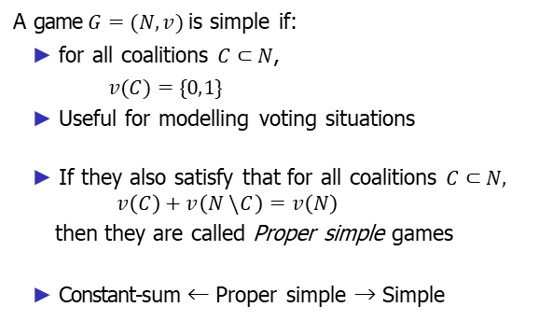
Simple games
A game $G=(N, v )$is simple if:
for all coalitions $C⊂N$,
$v (C )=\{0, 1\}$
Useful for modelling voting situations
If they also satisfy that for all coalitions $C⊂N,$
$$v \left(C \right)+v \left(N \backslash C \right)=v \left(N\right)$$
then they are called Proper simple games
Constant-sum ← Proper simple → Simple
10/2/2024
FIT5226-S2-2024
15/40
Notes:
Simple games are defined as follows:
A game 𝐺 = (𝑁, 𝑣) is simple if for all coalitions 𝐶⊂𝑁, the worth 𝑣(𝐶) can take only two values, 0 or 1. These games are particularly useful for modeling voting situations, where each member can vote (1) or not vote (0).
Furthermore, if these simple games satisfy the additional condition that for all coalitions 𝐶⊂𝑁, the sum of the worth of the coalition 𝑣(𝐶) and the worth of the complement of the coalition 𝑣(𝑁\𝐶) equals the worth of the grand coalition 𝑣(𝑁), then they are called Proper simple games.
In simpler terms, simple games are binary (0 or 1) and represent situations where agents are either in favor (1) or against (0) a particular decision or outcome. If these games also adhere to the "additivity" condition where the sum of the values of a coalition and its complement equals the worth of the entire group, they are classified as Proper simple games.
Proper simple games can be related to voting scenarios, where each member's vote is represented as 1 for a "yes" vote and 0 for a "no" vote. The additivity condition reflects the idea that the worth of the entire group should be conserved when considering the preferences of individual coalitions.
These simple games have implications in areas where decisions are made through voting or approval processes, and they provide a straightforward representation of individual preferences in a group setting.

Slide 16
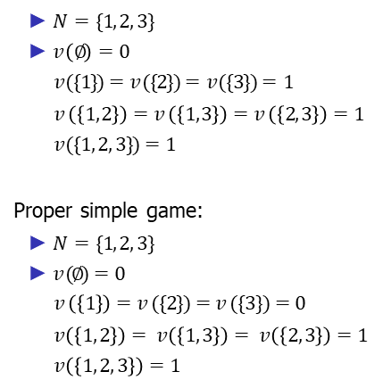
Example: Simple games
$N=\{1, 2, 3\}$
$v \left(∅\right)=0$
$v (\{1\})=v (\{2\})=v (\{3\})=1$
$$v \left(\left\{1, 2\right\}\right)=v \left(\left\{1, 3\right\}\right)=v \left(\left\{2, 3\right\}\right)=1$$
$v (\{1, 2, 3\})=1$
Proper simple game:
$N=\{1, 2, 3\}$
$v (∅)=0$
$v \left(\left\{1\right\}\right)=v (\{2\})=v (\{3\})=0$
$$v \left(\left\{1, 2\right\}\right)= v \left(\left\{1, 3\right\}\right)= v \left(\left\{2, 3\right\}\right)=1$$
$v \left(\left\{1, 2, 3\right\}\right)=1$
10/2/2024
FIT5226-S2-2024
16/40
Notes:
Simple games are typically binary, where the worth of a coalition can take on only two values: 0 or 1. They are commonly used to model voting scenarios, where each agent can either be in favor (1) or against (0) a specific decision or outcome. Let's look at an example of simple games:
Example 1 - Simple Game:
𝑁 = {1, 2, 3}
The worth of an empty coalition 𝑣(∅) is 0.
Each individual agent's worth is 1: 𝑣({1}) = 𝑣({2}) = 𝑣({3}) = 1.
Worth of any pair of agents or all three together is 1: 𝑣({1, 2}) = 𝑣({1, 3}) = 𝑣({2, 3}) = 1.
The worth of the grand coalition, where all agents are together, is 1: 𝑣({1, 2, 3}) = 1.
Example 2 - Proper Simple Game:
𝑁 = {1, 2, 3}
The worth of an empty coalition 𝑣(∅) is 0.
In this case, each individual agent's worth is 0: 𝑣({1}) = 𝑣({2}) = 𝑣({3}) = 0.
Worth of any pair of agents or all three together is 1: 𝑣({1, 2}) = 𝑣({1, 3}) = 𝑣({2, 3}) = 1.
The worth of the grand coalition, where all agents are together, is 1: 𝑣({1, 2, 3}) = 1.
In these examples, all coalitions either have a total worth of 0 or 1, making them simple games. Proper simple games are a subset of simple games where the worth of all individual agents is 0, and the worth is 1 only for coalitions that include multiple agents. These games are commonly used to model scenarios where individuals can approve or disapprove of a decision or outcome, and the focus is on the collective preferences and outcomes.

Slide 17
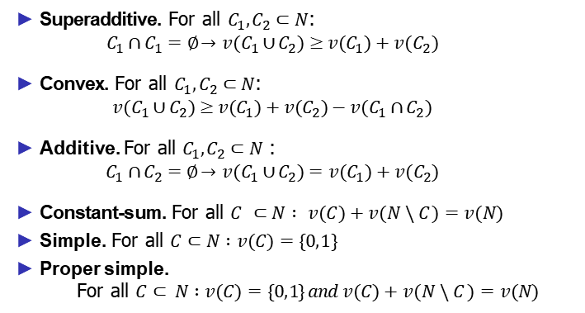
Summary: Classes of coalitional games
Superadditive. For all $C_{1}, C_{2}⊂N$:
$$C_{1}∩ C_{1}=∅ →v (C_{1}∪ C_{2})≥v (C_{1})+v (C_{2})$$
Convex. For all $C_{1}, C_{2}⊂N$:
$$v (C_{1}∪ C_{2})≥v (C_{1})+v (C_{2})−v (C_{1}∩ C_{2})$$
Additive. For all $C_{1}, C_{2}⊂N$:
$$C_{1}∩ C_{2}=∅ →v (C_{1}∪ C_{2})=v (C_{1})+v (C_{2})$$
Constant-sum. For all $C ⊂N : v (C )+v (N \backslash C )=v (N)$
Simple. For all $C⊂N :v (C )=\{0, 1\}$
Proper simple.
For all $C⊂ N :v (C )=\{0, 1\} and v (C )+v (N \backslash C )=v (N)$
10/2/2024
FIT5226-S2-2024
17/40
Notes:
Here's a summary of different classes of coalitional games based on their properties:
Superadditive Games:
For all coalitions $C_{1}, C_{2}⊂N$:
If $C_{1}∩ C_{2}=∅$, then $v (C_{1}∪ C_{2})≥v (C_{1})+v (C_{2})$
These games ensure that the worth of a coalition is at least as much as the sum of the worth of its disjoint subcoalitions.
Convex Games:
For all coalitions $C_{1}, C_{2}⊂N$:
$v (C_{1}∪ C_{2})≥v (C_{1})+v (C_{2})−v (C_{1}∩ C_{2})$
These games are similar to superadditive games but allow for a slight reduction in worth when two disjoint coalitions merge.
Additive Games:
For all coalitions $C_{1}, C_{2}⊂N$:
If $C_{1}∩ C_{2}=∅, then v (C_{1}∪ C_{2})=v (C_{1})+v (C_{2})$
In additive games, the worth of a coalition is exactly equal to the sum of the worth of its disjoint subcoalitions.
Constant-Sum Games:
For all coalitions 𝐶⊂𝑁:
𝑣 (𝐶 )+𝑣 (𝑁\𝐶 )=𝑣 (𝑁)
In constant-sum games, the total worth of the grand coalition (all players) remains constant.
Simple Games:
For all coalitions 𝐶⊂𝑁:
𝑣 (𝐶 ) can only be 0 or 1.
Simple games are binary, where the worth of a coalition can only be either 0 or 1, often used for modeling voting scenarios.
Proper Simple Games:
For all coalitions 𝐶⊂𝑁:
𝑣 (𝐶 ) can only be 0 or 1.
Additionally, 𝑣 (𝐶 )+𝑣 (𝑁\𝐶 )=𝑣 (𝑁).
Proper simple games are a subset of simple games where the total worth of all coalitions is 0 or 1, and the worth of the grand coalition is 1.
These classes of coalitional games provide a framework for modeling various scenarios in cooperative game theory, each with different properties and characteristics.

Slide 18
A hierarchy of coalitional games
Constant-sum ← Additive → Convex → Superadditive
↑
Proper Simple → Simple
Additive and proper simple are the smallest classes
Exercise: show every inclusion
10/2/2024
FIT5226-S2-2024
18/40
Notes:
To demonstrate the hierarchy and show how each class is included within the other:
Proper Simple → Simple:
Proper simple games are a subset of simple games. All proper simple games are simple, but not all simple games are proper simple.
Simple → Additive:
Simple games can be additive. In a simple game, if you have two disjoint coalitions, their combined worth can be the sum of their individual worth, making it additive.
Additive → Convex:
Additive games can be convex. If an additive game satisfies the condition for convexity, it becomes a convex game.
Convex → Superadditive:
Convex games can be superadditive. If a convex game satisfies the superadditive condition, it becomes a superadditive game.
Constant-Sum → Additive:
Constant-sum games can be additive. If the total worth of the grand coalition in a constant-sum game can be divided into smaller coalitions without loss, it becomes additive.
This hierarchy demonstrates how each class of coalitional games encompasses or extends the properties of the previous class. Proper simple and simple games are the most restrictive, while constant-sum and superadditive games provide more flexibility and complexity in terms of worth distribution among coalitions.

Slide 19
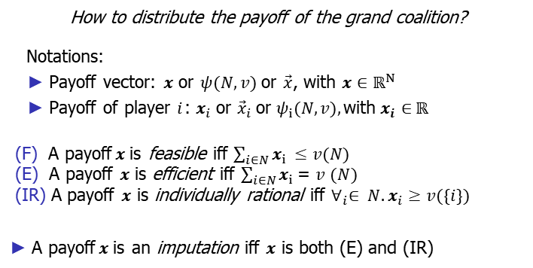
Analysing coalitional games
How to distribute the payoff of the grand coalition?
Notations:
Payoff vector: $x$ or $ψ(N, v)$or $\vec{x}$, with $x∈ℝ^{N}$
Payoff of player $i$ :$x_{i}$or ${\vec{x}}_{i}$ or $ψ_{i}(N, v),$with $x_{i}$ $∈ ℝ$
(F) A payoff$x$is feasible iff $\sum_{i∈N}{x_{i }≤v(N) }$
(E) A payoff $x$ is efficient iff $\sum_{i∈N}{x_{i} \text{= }v (N) }$
(IR) A payoff $x$ is individually rational iff $∀_{i}∈ N. x_{i}≥v(\{i\})$
A payoff$x$is an imputation iff $x$ is both (E) and (IR)
$v\left(N\right)$: the value of the grand coalition (budget)
10/2/2024
FIT5226-S2-2024
19/40
Notes:
When analyzing coalitional games, it's essential to understand how to distribute the payoff of the grand coalition, and various notations and concepts come into play:
Payoff Vector:
Denoted as 𝒙 or 𝜓(𝑁, 𝑣) or $\vec{x}$, where $x ∈ ℝ^{N}$.
Represents the distribution of payoffs among individual players.
Payoff of Player 𝑖:
Denoted as $x_{i}$or ${\vec{x}}_{i}$or $ψ_{i}(N, v),$where $x_{i} ∈ ℝ.$
Represents the payoff received by a specific player 𝑖.
Feasible (F):
A payoff 𝒙 is considered feasible if it satisfies the condition $\sum_{i∈N}{x_i} ≥ v(N$).
In simpler terms, the total payoff allocated to individual players should not exceed the value of the grand coalition.
Efficient (E):
A payoff 𝒙 is efficient if it satisfies the condition $\sum_{i∈N}{x_i} = v(N$).
This implies that the entire worth of the grand coalition is efficiently allocated among the players.
Individually Rational (IR):
A payoff 𝒙 is individually rational if it satisfies the condition $∀_{i}∈ N. x_{i} ≥ v(\{i\}).$
Each player should receive at least the worth of their own coalition.
Imputation:
An imputation is a payoff that meets the criteria of both efficiency (E) and individual rationality (IR). In other words, it is both efficient and ensures that each player receives at least their individual worth.
In summary, these notations and concepts help in evaluating how payoffs are distributed in a coalitional game, ensuring fairness, efficiency, and individual rationality. An imputation is a particularly significant concept as it represents a fair and efficient payoff distribution.

Slide 20
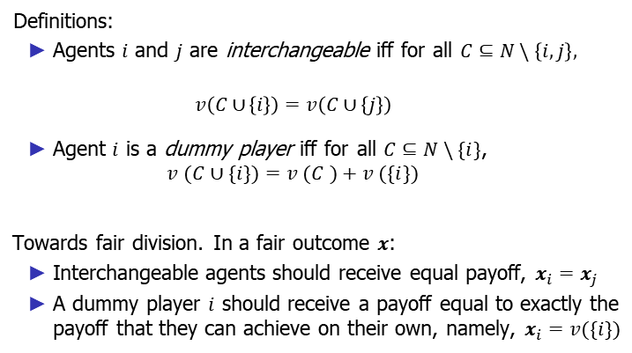
The Shapley value: Fair division
Definitions:
Agents $i$ and $j$ are interchangeable iff for all $C⊆N \backslash \left\{i, j\right\},$
$$v \left(C∪ \left\{i\right\}\right)=v \left(C∪ \left\{j\right\}\right)$$
Agent $i$ is a dummy player iff for all $C⊆N \backslash \{i\}$,
$$v (C∪\{i\})=v (C )+v (\{i\})$$
Towards fair division. In a fair outcome $x$:
Interchangeable agents should receive equal payoff, $x_{i}=x_{j}$
A dummy player $i$ should receive a payoff equal to exactly the payoff that they can achieve on their own, namely, $x_{i}=v(\{i\})$
10/2/2024
FIT5226-S2-2024
20/40
Notes:
In the context of the Shapley value and fair division, the following definitions and principles are important:
Interchangeable Agents:
Agents 𝑖 and 𝑗 are considered interchangeable if, for all coalitions 𝐶⊆𝑁 that does not contain either 𝑖 or 𝑗, the worth of the coalition after adding agent 𝑖 is equal to the worth of the coalition after adding agent 𝑗:
𝑣 (𝐶∪ {𝑖}) = 𝑣 (𝐶∪ {𝑗}).
Dummy Player:
An agent 𝑖 is classified as a dummy player if, for all coalitions 𝐶 that do not include 𝑖 (𝑁 \ {𝑖}), the worth of the coalition after adding agent 𝑖 is equal to the worth of the original coalition 𝐶 plus the worth of agent 𝑖:
𝑣 (𝐶∪{𝑖}) = 𝑣 (𝐶) + 𝑣 ({𝑖}).
In the pursuit of fair division:
Interchangeable Agents: Agents that are interchangeable should receive equal payoffs in a fair outcome, denoted as $x_{i} = x_{j}$.
Dummy Player: A dummy player 𝑖 should receive a payoff that is exactly equal to the payoff that they can achieve on their own, which is represented as $x_{i}$= 𝑣({𝑖}).
These principles ensure that agents are treated fairly, and each receives a share of the total value that accurately reflects their contributions and capabilities.

Slide 21
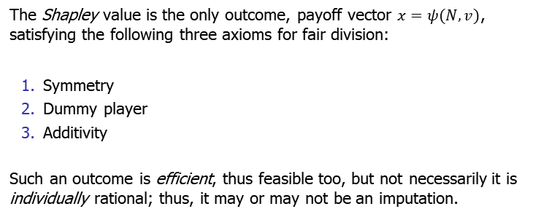
The Shapley value: Axioms
The Shapley value is the only outcome, payoff vector $x=ψ(N, v)$, satisfying the following three axioms for fair division:
Symmetry
Dummy player
Additivity
Such an outcome is efficient, thus feasible too, but not necessarily it is individually rational; thus, it may or may not be an imputation.
10/2/2024
FIT5226-S2-2024
21/40
Notes:
The Shapley value is a unique solution for fair division, characterized by its adherence to three fundamental axioms:
Symmetry: The Shapley value exhibits symmetry, meaning that if two agents contribute equally to all possible coalitions, they should receive the same payoff. In mathematical terms, for agents 𝑖 and 𝑗, if 𝑣 (𝐶∪ {𝑖}) = 𝑣 (𝐶∪ {𝑗}) for all coalitions 𝐶 that does not contain either 𝑖 or 𝑗, then the Shapley value assigns equal payoffs to 𝑖 and 𝑗.
Dummy Player: The Shapley value respects the "dummy player" axiom. A player is considered a "dummy" if their contribution to any coalition that does not include them is zero. In this case, the Shapley value ensures that the dummy player receives a payoff equal to what they can achieve on their own, which is precisely the value of their individual contribution.
Additivity: The Shapley value satisfies the "additivity" axiom. This means that the value assigned to a coalition is the sum of the values assigned to its disjoint subcoalitions. In other words, for all coalitions $C_{1}$and $C_{2}$that are mutually exclusive (i.e., $C_{1}∩ C_{2}$= ∅), the Shapley value assigns the total worth of the union of these coalitions as the sum of the worth of $C_{1}$and $C_{2}$.
The Shapley value adheres to these axioms to achieve fair division. It results in an efficient outcome, ensuring that the total value is distributed accurately among the agents. While it is efficient and feasible, it may not always be individually rational, and therefore, it may or may not be classified as an imputation.

Slide 22
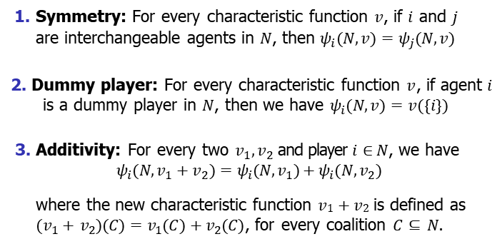
The Shapley value: Axioms
Symmetry: For every characteristic function $v$, if $i$ and $j$ are interchangeable agents in $N$, then $ψ_{i} (N, v )=ψ_{j}(N, v )$
Dummy player: For every characteristic function $v$ , if agent $i$
is a dummy player in $N$, then we have $ψ_{i}(N, v )=v (\{i\})$
Additivity: For every two $v_{1}, v_{2}$and player $i∈ N$, we have
$$ψ_{i}(N, v_{1}+v_{2})=ψ_{i}(N, v_{1})+ψ_{i}(N, v_{2})$$
where the new characteristic function $v1+v2$is defined as $(v_{1}+ v_{2})(C )=v_{1}(C )+v_{2}(C )$, for every coalition $C⊆ N$.
10/2/2024
FIT5226-S2-2024
22/40
Notes:
The Shapley value adheres to three essential axioms for fair division:
Symmetry: For any characteristic function 𝑣, if agents 𝑖 and 𝑗 are interchangeable within the set 𝑁, the Shapley value ensures that the payoff assigned to 𝑖 in the game (𝑁, 𝑣) is identical to the payoff assigned to 𝑗, denoted as $ψ_{i} (N, v) = ψ_{j}(N, v).$
Dummy Player: If agent 𝑖 is considered a dummy player within the set 𝑁, the Shapley value guarantees that their payoff in the game (𝑁, 𝑣) is precisely equal to the value that they can achieve on their own, as expressed by $ψ_{i}$(𝑁, 𝑣) = 𝑣 ({𝑖}).
Additivity: For any two characteristic functions $v_{1}$and $v_{2}$ and any player 𝑖 ∈ 𝑁, the Shapley value retains the property of additivity. This means that the Shapley value for player 𝑖 in the game ($N, v_{1}+v_{2}$), where the new characteristic function ($v_{1}+v_{2}$) is defined as the sum of the individual functions ($v_{1} + v_{2}$), is equal to the sum of the Shapley values for player 𝑖 in the games (𝑁, $v_{1}$) and (𝑁, $v_{2}$). Mathematically, it is represented as:
$ψ_{i}(N, v_{1}+v_{2}) = ψ_{i}(N, v_{1}) + ψ_{i} (N, v_{2})$
These axioms collectively define the Shapley value and ensure its fairness and consistency in the distribution of values among the agents in coalitional games.

Slide 23
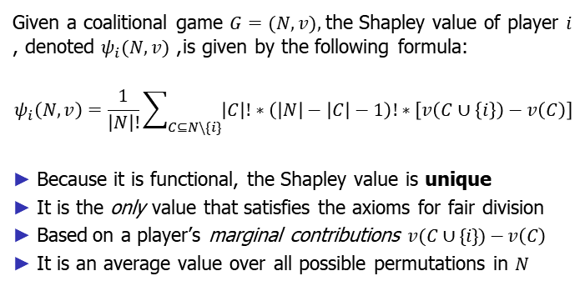
The Shapley value: Formal definition
Given a coalitional game $G=(N, v),$the Shapley value of player $i$ , denoted $ψ_{i}(N, v)$, is given by the following formula:
$$ψ_{i}\left(N,v\right)=\frac{1}{\left|N\right|!}\sum_{C⊆N\backslash \{i\}}{\left|C\right|!∗\left(\left|N\right|−\left|C\right|−1\right)!∗\left[v\left(C∪\left\{i\right\}\right)−v\left(C\right)\right]}$$
Because it is functional, the Shapley value is unique
It is the only value that satisfies the axioms for fair division
Based on a player’s marginal contributions $v (C∪ \{i\})−v \left(C \right)$
It is an average value over all possible permutations in $N$
marginal contributions
10/2/2024
FIT5226-S2-2024
23/40
Notes:
The Shapley value of a player 𝑖 in a coalitional game 𝐺 = (𝑁, 𝑣) is formally defined as follows:
$ψ_{i}\left(N,v\right)=\frac{1}{\left|N\right|!}\sum_{C⊆N\backslash \{i\}}{\left|C\right|!∗\left(\left|N\right|−\left|C\right|−1\right)!∗\left[v\left(C∪\left\{i\right\}\right)−v\left(C\right)\right]}$
Key characteristics and properties of the Shapley value include:
Uniqueness: The Shapley value is unique, meaning there is only one solution for each player in a given coalitional game. This uniqueness ensures consistency in the allocation of values.
Axiomatic Fairness: The Shapley value is the only value that satisfies the axioms for fair division, as previously defined. These axioms include symmetry, dummy player, and additivity.
Marginal Contributions: The Shapley value is calculated based on a player's marginal contributions to coalitions. It quantifies the impact of a player's participation in different coalitions within the game.
Average Value: The Shapley value is computed as an average value over all possible permutations of the players in the set 𝑁. It considers all possible orders in which players can join the game.
The Shapley value is a powerful concept in coalitional game theory, providing a fair and consistent way to distribute the value generated by cooperative actions among the participating players.

Slide 24
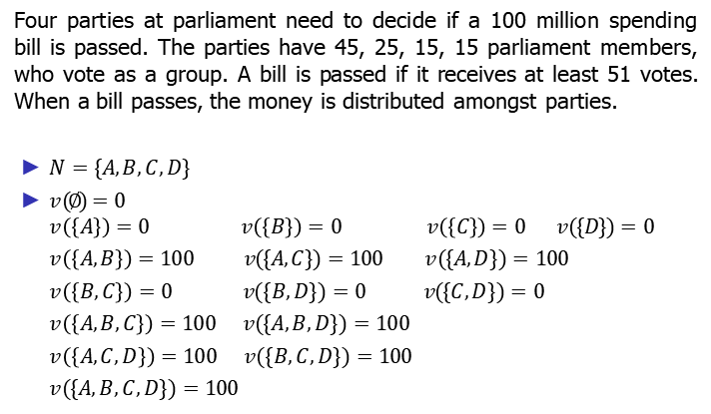
Example: Shapley value – Fair division in the voting game
Four parties at parliament need to decide if a 100 million spending bill is passed. The parties have 45, 25, 15, 15 parliament members, who vote as a group. A bill is passed if it receives at least 51 votes. When a bill passes, the money is distributed amongst parties.
$N=\{A, B, C, D\}$
$v (∅)=0$
$$v \left(\left\{A\right\}\right)=0 v \left(\left\{B\right\}\right)=0 v \left(\left\{C\right\}\right)=0 v (\{D\})=0$$
$v \left(\left\{A, B\right\}\right)=100 v (\{A, C\})=100$ $v (\{A, D\})=100$
$v \left(\left\{B, C\right\}\right)=0 v (\{B, D\})=0$ $v (\{C, D\})=0$
$v \left(\left\{A, B, C\right\}\right)=100 v (\{A, B, D\})=100$
$v \left(\left\{A, C, D\right\}\right)=100 v (\{B, C, D\})=100$
$v (\{A, B, C, D\})=100$
10/2/2024
FIT5226-S2-2024
24/40
Notes:
In the context of the voting game for the fair division of a 100 million spending bill among four parties (𝐴, 𝐵, 𝐶, 𝐷), the Shapley value can be calculated for each party. The characteristic function 𝑣 describes the worth of different coalitions in terms of whether they secure the passage of the bill and how the money is distributed.
Let's compute the Shapley value for each party:
1. Party 𝐴:
- When 𝐴 is added first: 𝑣 ({𝐴}) = 0
- When 𝐴 is added second (with 𝐵): 𝑣 ({𝐴, 𝐵}) = 100
- When 𝐴 is added second (with 𝐶): 𝑣 ({𝐴, 𝐶}) = 100
- When 𝐴 is added second (with 𝐷): 𝑣 ({𝐴, 𝐷}) = 100
- When 𝐴 is added third (with 𝐵 and 𝐶): 𝑣 ({𝐴, 𝐵, 𝐶}) = 100
- When 𝐴 is added third (with 𝐵 and 𝐷): 𝑣 ({𝐴, 𝐵, 𝐷}) = 100
- When 𝐴 is added third (with 𝐶 and 𝐷): 𝑣 ({𝐴, 𝐶, 𝐷}) = 100
- When 𝐴 is added fourth (with all parties): 𝑣 ({𝐴, 𝐵, 𝐶, 𝐷}) = 100
Now, calculate the Shapley value for 𝐴:
𝜓_𝐴 (𝑁, 𝑣) = 1/4! * [𝑣 ({𝐴}) + 3 * (𝑣 ({𝐴, 𝐵}) - 𝑣 ({𝐴})) + 3 * (𝑣 ({𝐴, 𝐶}) - 𝑣 ({𝐴})) + 3 * (𝑣 ({𝐴, 𝐷}) - 𝑣 ({𝐴})) + (𝑣 ({𝐴, 𝐵, 𝐶, 𝐷}) - 𝑣 ({𝐴}))]
Calculate this value to find the Shapley value for 𝐴. Repeat this process for parties 𝐵, 𝐶, and 𝐷 to determine their Shapley values. The Shapley value represents each party's fair share in the distribution of the 100 million based on their influence within different coalitions.

Slide 25
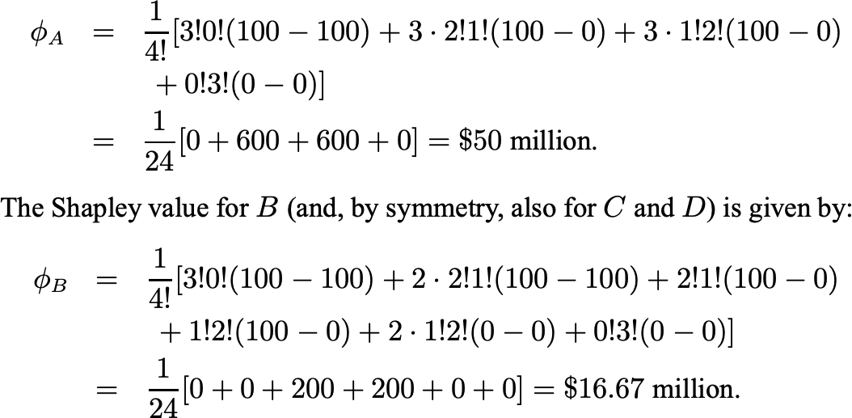


Example: Shapley value – Fair division in the voting game¹
$$ψ_{A}$$
$$ψ_{B}$$
Shapley value $x=\left(ψ_{A}, ψ_{B}, ψ_{C}, ψ_{D}\right)=(50, 16.67, 16.67, 16.67)$
¹Solution taken from the main textbook.
10/2/2024
FIT5226-S2-2024
25/40
Notes:
In the provided example, we are calculating the Shapley values for a fair division in a voting game where four parties are involved in deciding the distribution of a 100 million spending bill. Each party has a different number of parliament members. Let's break down the calculations for Shapley values for party A and party B (which is symmetrical for C and D):
Shapley Value for Party A (φ_A):
The formula used is:
$ψ_{A} = \frac{1}{4!}\left[3!⋅ 0!\left(100−100\right)+ 3⋅ 2!⋅ 1!\left(100−0\right)+ 3⋅ 1!⋅ 2!\left(100−0\right)+ 0!⋅ 3!\left(0−0\right)\right]$
Breaking down the calculation step by step:
For the case when party A arrives first, the worth doesn't change because it has no other players to join with (0).
For the case when party A arrives second (and there are three factorial ways to arrange the other parties), it joins party B, and together they have 3 members. In this case, the worth increases by 100.
For the case when party A arrives third (and there are three factorial ways to arrange the other parties), it joins parties B and C, and together they have 4 members. In this case, the worth increases by 100.
For the case when party A arrives last, it joins parties B, C, and D, and together they have 4 members. In this case, the worth doesn't change because the bill has already passed.
Now, let's calculate φ_A:
$ψ_{A} = \frac{1}{24}\left[0 + 600 + 600 + 0\right] = \$50 million$
Shapley Value for Party B (φ_B):
Using the same formula, we calculate $ψ_{B}$. The key difference is that party B arrives first and party A is the second to arrive. Here's the calculation:
$ψ_{B} = \frac{1}{41}\left[3!⋅ 0!\left(100−100\right)+ 2⋅ 2!⋅ 1!\left(100−100\right)+ 2!⋅ 1!\left(100−0\right)+ 1!⋅ 2!\left(100−0\right)+ 2⋅ 1!⋅ 2!\left(0−0\right)+ 0!⋅ 3!\left(0−0\right)\right]$
Simplifying step by step:
For the case when party B arrives first, the worth doesn't change because it has no other players to join with (0).
For the case when party B arrives second (and there are two factorial ways to arrange the other parties), it joins party A, and together they have 3 members. In this case, the worth doesn't change because the bill has already passed.
For the case when party B arrives third, it joins party A and either C or D. There are two possible arrangements (2 factorial) for the other parties. In this case, the worth increases by 100 for each arrangement.
Calculating $ψ_{B}$:
$ψ_{B} = \frac{1}{24}\left[0 + 0 + 200 + 200 + 0 + 0\right] = \$16.67 million$
So, the Shapley value for Party A is $50 million, and the Shapley value for Party B (as well as Parties C and D) is approximately $16.67 million.
The Shapley value vector 𝒙 = $(ψ_{A}, ψ_{B}, ψ_{C}, ψ_{D})$= ($50 million, $16.67 million, $16.67 million, $16.67 million).

Slide 26
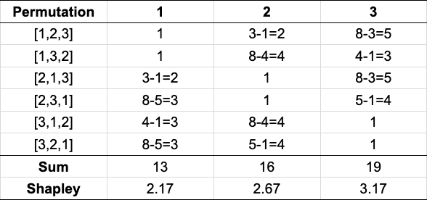
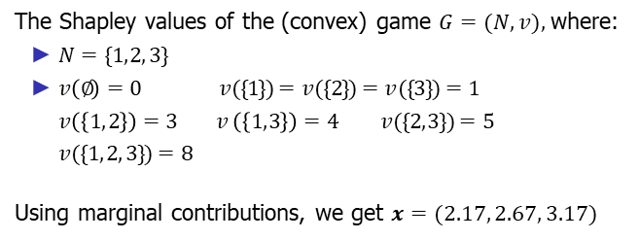
Example: Computing the Shapley values of a game
The Shapley values of the (convex) game $G=(N, v),$where:
$N=\{1, 2, 3\}$
$v \left(∅\right)=0 v (\{1\})=v (\{2\})=v (\{3\})=1$
$v \left(\left\{1, 2\right\}\right)=3 v \left(\left\{1, 3\right\}\right)=4 v (\{2, 3\})=5$
$v (\{1, 2, 3\})=8$
Using marginal contributions, we get $x=(2.17, 2.67, 3.17)$
$$v\left(\left\{1,2,3\right\}\right)−v\left(\left\{1,2\right\}\right)$$
10/2/2024
FIT5226-S2-2024
26/40
Notes:
In the given example, we are computing the Shapley values for a convex game, where three players are involved. Here's the breakdown of the Shapley values using marginal contributions:
Game Characteristics:
Set of Players: 𝑁 = {1, 2, 3}
Characteristic Function: 𝑣 (∅) = 0, 𝑣 ({1}) = 𝑣 ({2}) = 𝑣 ({3}) = 1
Additional Values: 𝑣 ({1, 2}) = 3, 𝑣 ({1, 3}) = 4, 𝑣 ({2, 3}) = 5, 𝑣 ({1, 2, 3}) = 8
Calculation of Shapley Values:
First, we calculate the marginal contributions for each player by considering all possible permutations (orderings) of the players. For each permutation, we calculate the change in worth when a player joins the coalition. The permutations considered are [1, 2, 3], [1, 3, 2], [2, 1, 3], [2, 3, 1], [3, 1, 2], and [3, 2, 1].
For each permutation, we compute the change in worth for each player and then calculate the sum of these changes for each player.
The Shapley value for each player is obtained by averaging the sum of their marginal contributions over all possible permutations.
Detailed Calculation for Player 1 ($ψ_{1}$):
The change in worth when player 1 joins the coalition in permutation [1, 2, 3] is 1.
The change in worth when player 1 joins the coalition in permutation [1, 3, 2] is 1.
The change in worth when player 1 joins the coalition in permutation [2, 1, 3] is 2.
The change in worth when player 1 joins the coalition in permutation [2, 3, 1] is 3.
The change in worth when player 1 joins the coalition in permutation [3, 1, 2] is 3.
The change in worth when player 1 joins the coalition in permutation [3, 2, 1] is 3.
The sum of changes in worth for player 1 is 1 + 1 + 2 + 3 + 3 + 3 = 13.
To get the Shapley value for player 1, we take the average of these sums, which is 13 / 6 = 2.17.
Summary of Shapley Values:
The Shapley values for each player are as follows:
Player 1: $ψ_{1}$= 2.17
Player 2: $ψ_{2}$= 2.67
Player 3: $ψ_{3}$= 3.17
These Shapley values represent the fair distribution of the total worth of the coalition game among the players.

Slide 27
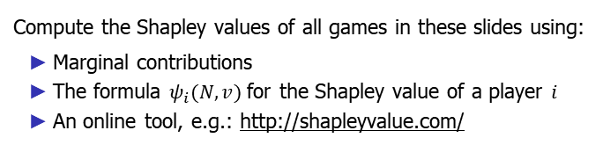
Exercise: Computing the Shapley values of a game
Compute the Shapley values of all games in these slides using:
Marginal contributions
The formula $ψ_{i}(N, v)$for the Shapley value of a player $i$
An online tool, e.g.: http://shapleyvalue.com/
10/2/2024
FIT5226-S2-2024
27/40
Notes:
To compute the Shapley values of the games in the slides, you can follow these steps:
Marginal Contributions Method:
For each player 𝑖, calculate their marginal contributions for all possible permutations of players in 𝑁.
Average these marginal contributions to determine the Shapley value for each player.
Formula 𝜓_𝑖 (𝑁, 𝑣):
Use the Shapley value formula:
$ψ_{i}\left(N,v\right)=\frac{1}{\left|N\right|!}\sum_{C⊆N\{i\}}{\left|C\right|!∗\left(\left|N\right|−\left|C\right|−1\right)!∗\left[v\left(C∪\left\{i\right\}\right)−v\left(C\right)\right]}$
Calculate the Shapley value for each player 𝑖 using this formula.
Online Tools:
You can use online Shapley value calculators like http://shapleyvalue.com/ to compute the Shapley values for the given characteristic functions. These tools often provide a user-friendly interface for entering the characteristic functions and obtaining the Shapley values.
It's important to ensure that the characteristic functions (𝑣) for each game are correctly defined, and then apply the chosen method to calculate the Shapley values.

Slide 28
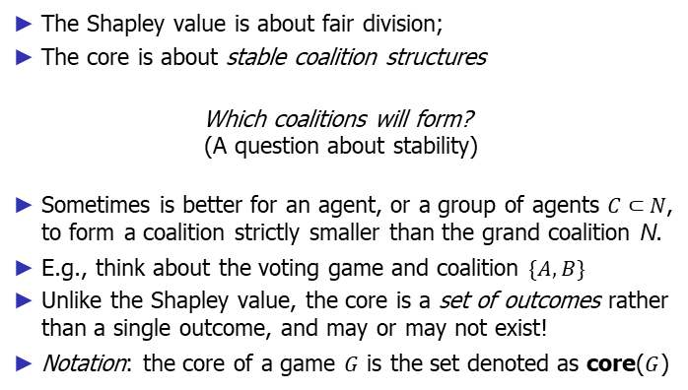
The core
The Shapley value is about fair division;
The core is about stable coalition structures
Which coalitions will form?
(A question about stability)
Sometimes is better for an agent, or a group of agents $C⊂N$, to form a coalition strictly smaller than the grand coalition N.
E.g., think about the voting game and coalition $\{A, B\}$
Unlike the Shapley value, the core is a set of outcomes rather than a single outcome, and may or may not exist!
Notation: the core of a game $G$ is the set denoted as core($G$)
10/2/2024
FIT5226-S2-2024
28/40
Notes:
The core of a coalition game is a concept related to stable coalition structures. While the Shapley value focuses on the fair division of payoffs among players, the core is concerned with the stability of the coalitions that form. The core answers the question of which coalitions will form and whether they are stable.
Here are some key points about the core of a game:
Stability of Coalition Structures: The core of a game addresses the stability of coalitions, which means it considers whether a group of agents (a coalition) would find it advantageous to cooperate and form a coalition structure.
Smaller Coalitions: In some cases, it may be better for agents or a group of agents (denoted as 𝐶⊂𝑁) to form a coalition that is strictly smaller than the grand coalition 𝑁. This implies that not all agents may choose to join the grand coalition.
Example: Think about a voting game where some agents may find it more advantageous to form smaller coalitions. For instance, a coalition like {𝐴, 𝐵} may be preferable to joining the grand coalition 𝑁. This choice is based on the perceived stability and benefit of the smaller coalition.
Set of Outcomes: Unlike the Shapley value, which provides a single outcome (a payoff vector), the core is a set of outcomes. The core represents a collection of possible coalition structures that are considered stable.
Existence of the Core: It's important to note that the core may or may not exist for a given coalition game. Whether the core exists depends on the specific characteristics and properties of the game.
Notation: The core of a game 𝐺 is denoted as core(𝐺), and it represents the set of stable outcomes or coalition structures within the game.
In summary, the core is a concept in coalition game theory that addresses the stability of coalition structures and investigates which coalitions will form among the players in a game. It provides a set of possible outcomes that are considered stable and can be crucial in understanding how coalitions are likely to be structured in cooperative situations.

Slide 29
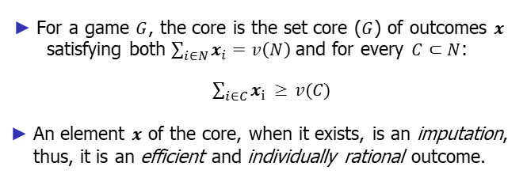
The core: Definition
For a game $G$, the core is the set core ($G$) of outcomes $x$
satisfying both $\sum_{i∈N}{x_{i}=v\left(N\right)}$ and for every $C⊂N$:
$\sum_{i∈C}{x_{i }≥ v (C ) }$
An element $x$ of the core, when it exists, is an imputation, thus, it is an efficient and individually rational outcome.
10/2/2024
FIT5226-S2-2024
29/40
Notes:
The core of a game is formally defined as follows:
For a game 𝐺, the core is the set core(𝐺) of outcomes 𝒙 satisfying two conditions:
Grand Coalition Payoff: $\sum_{i∈N}{x_{i}=v\left(N\right)}$ This condition ensures that the sum of the payoffs received by all players in the outcome 𝒙 equals the value of the grand coalition 𝑁. In other words, the total payoff distributed matches the total value of the coalition.
Coalitional Rationality: For every 𝐶⊂𝑁: $\sum_{i∈C}{x_{i }≥ v (C ) }$ This condition ensures that for every possible coalition 𝐶 within the grand coalition 𝑁, the sum of payoffs received by the players in that coalition is greater than or equal to the value of the coalition itself. This condition reflects that no subgroup of players can improve their situation by forming a smaller coalition.
An element 𝒙 belonging to the core, when it exists, is referred to as an imputation. Such an outcome is efficient, as it satisfies the condition that the total payoff equals the value of the grand coalition, and it is individually rational, as it ensures that each player receives at least their share according to the value of the coalition they belong to.
The core represents a set of outcomes that are considered stable in the sense that no subgroup of players has an incentive to deviate from the coalition structure that leads to these outcomes. It is an important concept in cooperative game theory and provides insight into the stability of coalition structures and the distribution of payoffs among players.

Slide 30
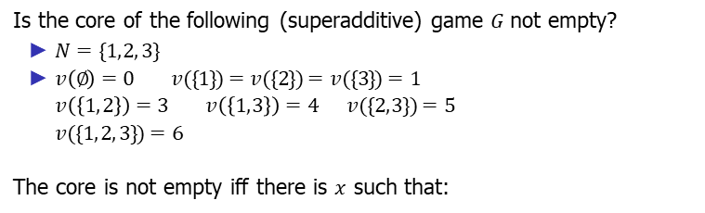
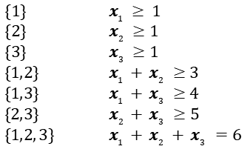

Example/Exercise: The core
Is the core of the following (superadditive) game $G$not empty?
$N=\{1, 2, 3\}$
$v \left(∅\right)=0 v (\{1\})=v (\{2\})=v (\{3\})=1$
$v \left(\left\{1, 2\right\}\right)=3 v \left(\left\{1, 3\right\}\right)=4 v (\{2, 3\})=5$
$v (\{1, 2, 3\})=6$
The core is not empty iff there is $x$ such that:
$\{1\}$ | $x_{1} ≥ 1$
$\{2\}$ | $x_{2} ≥1$
$\{3\}$ | $x_{3} ≥1$
$\{1, 2\}$ | $x_{1} + x_{2} ≥3$
$\{1, 3\}$ | $x_{1} + x_{3} ≥4$
$\{2, 3\}$ | $x_{2} + x_{3} ≥5$
$\{1, 2, 3\}$ | $$x_{1} + x_{2} + x_{3} =6$$
The core of $G$ is not empty: e.g., $x=(1, 2, 3)∈$ core($G$)
Note that the Shapley value of $G$ is$ψ(N, v )=(1.5, 2.0, 2.5)$
10/2/2024
FIT5226-S2-2024
30/40
Notes:
In this example/exercise, we are considering a superadditive game 𝐺 with the following characteristics:
Players: 𝑁 = {1, 2, 3}
Characteristic Function: 𝑣
𝑣 (∅) = 0
𝑣 ({1}) = 𝑣 ({2}) = 𝑣 ({3}) = 1
𝑣 ({1, 2}) = 3
𝑣 ({1, 3}) = 4
𝑣 ({2, 3}) = 5
𝑣 ({1, 2, 3}) = 6
The question is whether the core of this game 𝐺 is empty or not. The core is not empty if there exists an outcome 𝒙 that satisfies certain conditions for every possible coalition 𝐶⊆𝑁:
For every player 𝑖∈𝑁, 𝒙_𝑖 (the payoff of player 𝑖) is greater than or equal to 1.
For every coalition {1, 2}, the sum of the payoffs of players 1 and 2 is greater than or equal to 3.
For every coalition {1, 3}, the sum of the payoffs of players 1 and 3 is greater than or equal to 4.
For every coalition {2, 3}, the sum of the payoffs of players 2 and 3 is greater than or equal to 5.
For the grand coalition {1, 2, 3}, the sum of the payoffs of all three players is equal to 6.
The core of 𝐺 is not empty because there is an outcome 𝒙=(1, 2, 3) that satisfies all these conditions. This outcome is in the core of the game 𝐺, indicating that this coalition structure and payoff distribution are stable.
It's worth noting that the Shapley value of 𝐺 is 𝜓(𝑁, 𝑣) = (1.5, 2.0, 2.5), which represents a different way of distributing payoffs and may not necessarily be in the core. The core focuses on the stability of coalition structures, while the Shapley value focuses on the fairness of payoff distribution.

Slide 31
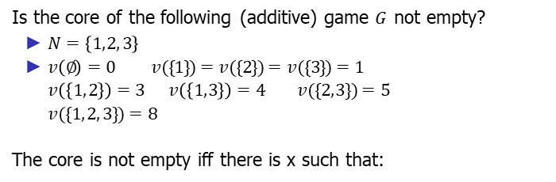
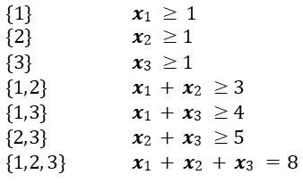

Example/Exercise: The core
Is the core of the following (additive) game $G$ not empty?
$N=\left\{1, 2, 3\right\}$
$v \left(∅\right)=0 v (\{1\})=v (\{2\})=v (\{3\})=1$
$v \left(\left\{1, 2\right\}\right)=3 v \left(\left\{1, 3\right\}\right)=4 v (\{2, 3\})=5$
$v (\{1, 2, 3\})=8$
The core is not empty iff there is x such that:
$\{1\}$ | $x1 ≥ 1$
$\{2\}$ | $x2 ≥1$
$\{3\}$ | $x3 ≥1$
$\{1, 2\}$ | $x1 + x2 ≥3$
$\{1, 3\}$ | $x1 + x3 ≥4$
$\{2, 3\}$ | $x2 + x3 ≥5$
$\{1, 2, 3\}$ | $$x1 + x2 + x3 =8$$
The core of $G$ is not empty again!
E.g., the Shapley value $ψ(N, v )=(2.17, 2.67, 3.17)∈$core($G$)
10/2/2024
FIT5226-S2-2024
31/40
Notes:
In this example/exercise, we are considering an additive game 𝐺 with the following characteristics:
Players: 𝑁 = {1, 2, 3}
Characteristic Function: 𝑣
𝑣 (∅) = 0
𝑣 ({1}) = 𝑣 ({2}) = 𝑣 ({3}) = 1
𝑣 ({1, 2}) = 3
𝑣 ({1, 3}) = 4
𝑣 ({2, 3}) = 5
𝑣 ({1, 2, 3}) = 8
The question is whether the core of this game 𝐺 is empty or not. The core is not empty if there exists an outcome 𝒙 that satisfies certain conditions for every possible coalition 𝐶⊆𝑁:
For every player 𝑖∈𝑁, 𝒙_𝑖 (the payoff of player 𝑖) is greater than or equal to 1.
For every coalition {1, 2}, the sum of the payoffs of players 1 and 2 is greater than or equal to 3.
For every coalition {1, 3}, the sum of the payoffs of players 1 and 3 is greater than or equal to 4.
For every coalition {2, 3}, the sum of the payoffs of players 2 and 3 is greater than or equal to 5.
For the grand coalition {1, 2, 3}, the sum of the payoffs of all three players is equal to 8.
The core of 𝐺 is not empty because there is an outcome 𝒙=(2.17, 2.67, 3.17) that satisfies all these conditions. This outcome is in the core of the game 𝐺, indicating that this coalition structure and payoff distribution are stable.
It's also worth mentioning that the Shapley value 𝜓(𝑁, 𝑣) = (2.17, 2.67, 3.17) is within the core, demonstrating that it's a stable and fair outcome for this game.

Slide 32
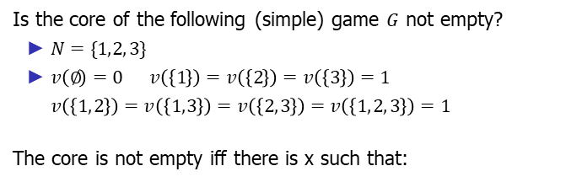
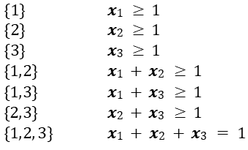

Example/Exercise: The core
Is the core of the following (simple) game $G$ not empty?
$N=\{1, 2, 3\}$
$v \left(∅\right)=0 v \left(\left\{1\right\}\right)=v \left(\left\{2\right\}\right)=v \left(\left\{3\right\}\right)=1$
$v \left(\left\{1, 2\right\}\right)=v \left(\left\{1, 3\right\}\right)=v \left(\left\{2, 3\right\}\right)=v \left(\left\{1, 2, 3\right\}\right)=1$
The core is not empty iff there is x such that:
$\{1\}$ | $x1 ≥ 1$
$\{2\}$ | $x2 ≥ 1$
$\{3\}$ | $x3 ≥ 1$
$\{1, 2\}$ | $x1 + x2 ≥ 1$
$\{1, 3\}$ | $x1 + x3 ≥ 1$
$\{2, 3\}$ | $x2 + x3 ≥ 1$
$\{1, 2, 3\}$ | $$x1 + x2 + x3 = 1$$
The core of $G$ is empty!
The Shapley value of $G$ is$ψ(N, v )=(0.33, 0.33, 0.33)$
10/2/2024
FIT5226-S2-2024
32/40
Notes:
In the case of the simple game 𝐺 with the following characteristic function:
𝑁={1, 2, 3}
𝑣 (∅)=0 𝑣 ({1})=𝑣 ({2})=𝑣 ({3})=1
𝑣 ({1, 2})=𝑣 ({1, 3})=𝑣 ({2, 3})=𝑣 ({1, 2, 3})=1
The core is empty in this case because there is no way to distribute the payoff among the players in a manner that satisfies both the group and individual rationality conditions. The Shapley value, 𝜓(𝑁, 𝑣 )=(0.33, 0.33, 0.33), provides a fair distribution based on marginal contributions, but it does not satisfy the core conditions for this game.
This example illustrates that not all cooperative games have non-empty cores. The existence of the core depends on the specific characteristics of the game and its characteristic function. In cases where the core is empty, other solution concepts like the Shapley value may provide a fair distribution of payoffs.

Slide 33
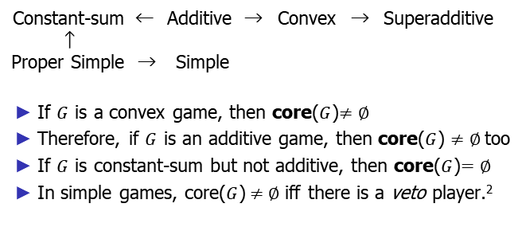
Properties of classes of games
Constant-sum ← Additive → Convex → Superadditive
↑
Proper Simple → Simple
If $G$ is a convex game, then core($G$)$≠∅$
Therefore, if $G$ is an additive game, then core($G$) $≠∅$too
If $G$ is constant-sum but not additive, then core($G$)$=∅$
In simple games, core($G$)$≠∅$iff there is a veto player.²
²Player i is a veto player iff v (N \ {i}) = 0.
10/2/2024
FIT5226-S2-2024
33/40
Notes:
The properties provide insights into the existence of the core for different classes of coalitional games:
Convex Games: If a game 𝐺 is convex, then it is guaranteed to have a non-empty core (core(𝐺)≠∅). Convex games inherently exhibit stability in the sense that players are incentivized to form coalitions that benefit them.
Additive Games: If a game 𝐺 is additive, it implies that core(𝐺)≠∅ as well. The additivity property ensures that the core is not empty, which means there are stable coalition structures.
Constant-Sum Games: For constant-sum games, if they are not additive, it doesn't necessarily imply that the core is empty. Some constant-sum games may have non-empty cores, so core(𝐺) can still be non-empty. The existence of the core in constant-sum games depends on the specific characteristics of the game.
Simple Games: In simple games, core(𝐺)≠∅ if and only if there is a veto player. A veto player is a player whose agreement is required for the formation of any winning coalition. If a game has a veto player, it ensures the core is not empty.
These properties offer valuable insights into the core's existence and stability within different classes of coalitional games, helping us understand when stable coalition structures are more likely to form.

Slide 34
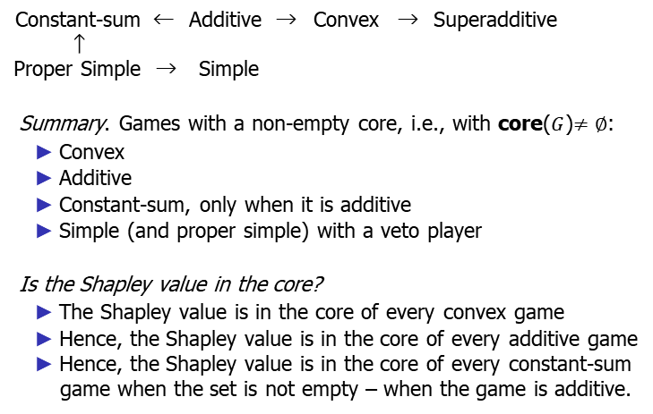
Properties of classes of games
Constant-sum ← Additive → Convex → Superadditive
↑
Proper Simple → Simple
Summary. Games with a non-empty core, i.e., with core($G$)$≠∅$:
Convex
Additive
Constant-sum, only when it is additive
Simple (and proper simple) with a veto player
Is the Shapley value in the core?
The Shapley value is in the core of every convex game
Hence, the Shapley value is in the core of every additive game
Hence, the Shapley value is in the core of every constant-sum game when the set is not empty – when the game is additive.
10/2/2024
FIT5226-S2-2024
34/40
Notes:
Your summary nicely captures the relationships between different classes of coalitional games and their cores, as well as the Shapley value's presence in the core:
Games with a Non-Empty Core: The core is guaranteed to be non-empty in the following types of games:
Convex games
Additive games
Constant-sum games, but only when they are additive
Simple (and proper simple) games that have a veto player
Shapley Value in the Core: The Shapley value is in the core of specific game types:
The Shapley value is in the core of every convex game.
Therefore, the Shapley value is in the core of every additive game.
The Shapley value is in the core of every constant-sum game when the core is not empty, which occurs when the game is additive.
These insights help us understand the relationships between different classes of games, their core properties, and the Shapley value's position within those cores.

Slide 35
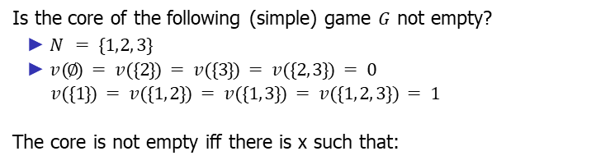
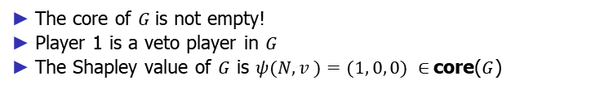
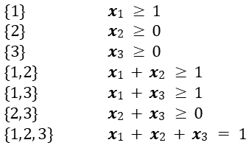
Example: The core and Shapley value in simple games
Is the core of the following (simple) game $G$ not empty?
$N = \{1, 2, 3\}$
$v (∅) = v (\{2\}) = v (\{3\}) = v (\{2, 3\}) = 0$
$v (\{1\}) = v (\{1, 2\}) = v (\{1, 3\}) = v (\{1, 2, 3\}) = 1$
The core is not empty iff there is x such that:
$\{1\}$ | $x1 ≥ 1$
$\{2\}$ | $x2 ≥ 0$
$\{3\}$ | $x3 ≥ 0$
$\{1, 2\}$ | $x1 + x2 ≥ 1$
$\{1, 3\}$ | $x1 + x3 ≥ 1$
$\{2, 3\}$ | $x2 + x3 ≥ 0$
$\{1, 2, 3\}$ | $$x1 + x2 + x3 = 1$$
The core of $G$is not empty!
Player 1 is a veto player in $G$
The Shapley value of $G$ is $ψ(N, v )=(1, 0, 0) ∈$core($G$)
10/2/2024
FIT5226-S2-2024
35/40
Notes:
In the given simple game G with characteristic function v, we have:
N = {1, 2, 3}
v(∅) = v({2}) = v({3}) = v({2, 3}) = 0
v({1}) = v({1, 2}) = v({1, 3}) = v({1, 2, 3}) = 1
The core of G is not empty, which means there are feasible payoff vectors (x) that satisfy both the individual rationality and group rationality conditions. Specifically, for a feasible payoff vector to be in the core, it should satisfy:
For player 1: x1 ≥ 1
For player 2: x2 ≥ 0
For player 3: x3 ≥ 0
For the coalition {1, 2}: x1 + x2 ≥ 1
For the coalition {1, 3}: x1 + x3 ≥ 1
For the coalition {2, 3}: x2 + x3 ≥ 0
For the grand coalition {1, 2, 3}: x1 + x2 + x3 = 1
The core is not empty, which means there exist payoff vectors that satisfy these conditions. In this game, player 1 acts as a veto player because they have the power to block any coalition formation.
Additionally, the Shapley value of this game, denoted as φ(N, v), is (1, 0, 0), and it also belongs to the core of the game. This further highlights the presence of a veto player in the game.

Slide 36
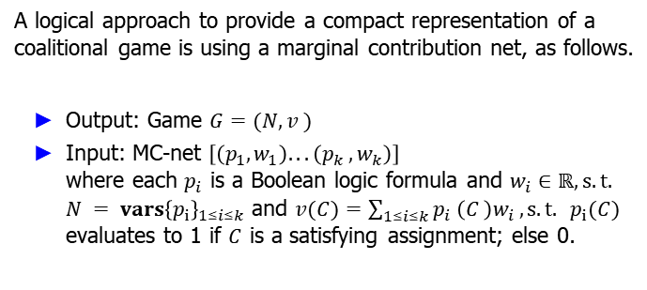
A compact representation: Marginal contribution nets
A logical approach to provide a compact representation of a coalitional game is using a marginal contribution net, as follows.
Output: Game $G=(N, v )$
Input: MC-net $\left[\left(p_{1}, w_{1}\right). . . \left(p_{k} , w_{k}\right)\right]$ where each $p_{i}$ is a Boolean logic formula and $w_{i}∈ℝ, s.t.$ $N = vars{\left\{p_{i}\right\}}_{1≤i≤k}$ and $v(C)=\sum_{1≤i≤k}{p_{i} \left(C \right)w_{i}}, s.t. p_{i}(C)$ evaluates to 1 if $C$ is a satisfying assignment; else 0.
10/2/2024
FIT5226-S2-2024
36/40
Notes:
A compact representation of a coalitional game can be achieved using a Marginal Contribution Net (MC-net). This approach allows for a concise and structured representation of the game. Here's the process to construct a coalitional game from an MC-net:
Output: Game 𝐺 = (𝑁, 𝑣)
Input: MC-net [(𝑝₁, 𝑤₁), (𝑝₂, 𝑤₂), ..., (𝑝ₖ, 𝑤ₖ)]
In the MC-net, each entry consists of a Boolean logic formula (𝑝ᵢ) and a corresponding weight (𝑤ᵢ), where 𝑖 ranges from 1 to 𝑘. These formulas are used to define the characteristic function of the game.
Player Set: Define the player set 𝑁 as the union of variables present in the Boolean formulas: 𝑁 = ∪𝑖 𝑉𝑎𝑟𝑠(𝑝ᵢ) for 1 ≤ 𝑖 ≤ 𝑘.
Characteristic Function: Define the characteristic function 𝑣(𝐶) for any coalition 𝐶 as follows:
𝑣(𝐶) = Σᵢ 𝑝ᵢ(𝐶) ⋅ 𝑤ᵢ
Here, 𝑝ᵢ(𝐶) evaluates to 1 if the coalition 𝐶 is a satisfying assignment for formula 𝑝ᵢ; otherwise, it evaluates to 0.
By defining the characteristic function in this way, you construct a coalitional game 𝐺 based on the given MC-net. This representation is more compact and structured, making it easier to work with and analyze the game. The MC-net approach offers a convenient way to represent complex games concisely using Boolean logic formulas and associated weights.

Slide 37
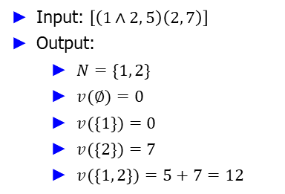
Example: Marginal contribution nets
Input: $\left[\left(1∧2, 5\right)\left(2, 7\right)\right]$
Output:
$N=\{1, 2\}$
$v(∅)=0$
$v(\{1\})=0$
$v(\{2\})=7$
$v(\{1, 2\})=5+7=12$
10/2/2024
FIT5226-S2-2024
37/40
Notes:
Let's create a coalitional game based on the provided MC-net input [(1∧2, 5), (2, 7)]:
Input: [(1∧2, 5), (2, 7)]
Output:
Player Set: 𝑁 = {1, 2}
Characteristic Function:
𝑣(∅) = 0 (The characteristic value of an empty coalition is always 0.)
𝑣({1}) = 0 (Using the first formula: 1∧2 evaluates to 0 when 1 is alone.)
𝑣({2}) = 7 (Using the second formula: 2 alone has a characteristic value of 7.)
𝑣({1, 2}) = 5 + 7 = 12 (Using the first formula, 1∧2 evaluates to 1 when both 1 and 2 are in the coalition.)
Step-by-Step Explanation:
$$v(C)=\sum_{1≤i≤k}{p_{i}\left(C\right)w_{i}}​$$
Understand the Components:
$v(C)$: The value of the coalition $C$.
$\sum_{1≤i≤k}{p_{i}\left(C\right)w_{i}}$: This represents the sum of all weights$w_{i}$where the Boolean condition $p_{i}$​ is satisfied for the coalition $C$.
$p_{i}\left(C\right)w_{i}$: Evaluates to 1 if the coalition $C$ satisfies the Boolean condition $p_{i}$, otherwise it evaluates to 0.
Given Data:
The input MC-net is $\left[\left(1∧2, 5\right), \left(2, 7\right)\right]$.
This means we have two rules:
$p_{1}= 1∧2, w_{1}= 5$
$p_{2}= 2, w_{2}= 7$
Evaluate Each Condition for Coalition $\{1,2\}$:
First Condition $p_{1}= 1∧2$:
This condition checks if both players 1 and 2 are in the coalition $p_{i}\left(C\right)w_{i}$.
Since $C=\{1,2\}$, the condition is satisfied, so $p_{1}\left(\left\{1, 2\right\}\right)=1$.
Therefore, the contribution from this condition is $p_{1}\left(\left\{1, 2\right\}\right)×w_{1}= 1 ×5 = 5.$
Second Condition $p_{2}= 2$:
This condition checks if player 2 is in the coalition $p_{i}\left(C\right)w_{i}$.
Since $C=\{1,2\}$, the condition is satisfied, so $p_{2}\left(\left\{1, 2\right\}\right)= 1$.
Therefore, the contribution from this condition is $p_{2}\left(\{1, 2\}\right)×w_{2}= 1 ×7 = 7$.
Calculate $v(\{1, 2\})$:
Sum the contributions from all the conditions: $v\left(\{1, 2\}\right)= \left(p_{1}\left(\{1, 2\}\right)×w_{1}\right)+ \left(p_{2}\left(\{1, 2\}\right)×w_{2}\right)= 5 + 7 = 12$

Slide 38
Exercises
Coalitional games’ hierarchy: Show the inclusions in page 18.
Shapley values and the core: Compute the Shapley values of all games as indicated in page 27, and in each case decide whether such an outcome is in the core of the game or not.
Let G be a simple game. Decide whether the following statement is true or false: G has a veto player iff G is additive.
10/2/2024
FIT5226-S2-2024
38/40
Notes:
Exercise 1: Coalitional Games' Hierarchy
The hierarchy of coalitional games you've provided on page 18 shows the relationships between different classes of games. Let's analyze the inclusions:
Constant-sum games are a subset of additive games.
Additive games are a subset of convex games.
Convex games are a subset of superadditive games.
Proper simple games are a subset of simple games.
Let's break down these inclusions:
Constant-sum → Additive: This is true. Every constant-sum game is additive. In a constant-sum game, the total value remains constant, and for any coalition, the sum of its value and the complement's value is constant. Therefore, it satisfies the properties of additive games.
Additive → Convex: This is true. Every additive game is convex. In an additive game, the value of a coalition formed by merging two disjoint coalitions is equal to the sum of their individual values, which satisfies the convexity property.
Convex → Superadditive: This is true. Every convex game is superadditive. The convexity property inherently implies that merging two disjoint coalitions cannot result in a value less than the sum of their individual values, which is a superadditive condition.
Proper Simple → Simple: This is true. Every proper simple game is simple. Proper simple games are a subset of simple games, which means they also satisfy the conditions for simplicity.
Exercise 3: Veto Players and Additive Games
Now, let's address the statement about veto players and additive games: "G has a veto player iff G is additive."
This statement is false. A veto player in a simple game G is a player whose absence from a coalition guarantees that the coalition's value is zero. Additive games and veto players are not directly related. A game can be additive without having a veto player, and a game can have a veto player without being additive.
In an additive game, the key property is that the value of a coalition is equal to the sum of the values of its members. This doesn't necessarily imply the presence of a veto player.
A veto player is a player whose presence is essential to achieve a positive value for a coalition. This concept relates more to the structure of the game and specific players' power rather than the additive property.
If you have any specific examples or further questions, please feel free to ask.

Slide 39
References
Some suggested readings:
Yoav Shoham and Kevin Leyton-Brown. Multiagent Systems: Algorithmic, Game-Theoretic, and Logical Foundations. Chapter 12, Cambridge University Press, 2008.
Michael Wooldridge. An Introduction to MultiAgent Systems. Chapter 13, Wiley, 2009.
10/2/2024
FIT5226-S2-2024
39/40

Slide 40
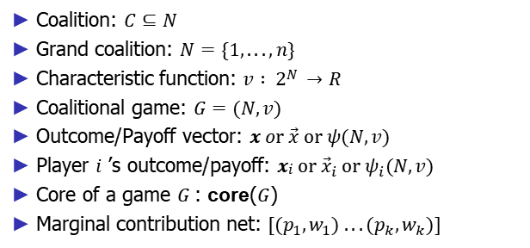
Summary of notations
Coalition: $C⊆N$
Grand coalition: $N=\{1, . . . , n\}$
Characteristic function: $v : 2N →R$
Coalitional game: $G=(N, v)$
Outcome/Payoff vector: $x or \vec{x} or ψ(N, v)$
Player $i$ ’s outcome/payoff: $xi or{ \vec{x}}_{i} or ψ_{i}(N, v)$
Core of a game $G$: core($G$)
Marginal contribution net: $[(p_{1}, w_{1}) . . . (p_{k}, w_{k})]$
10/2/2024
FIT5226-S2-2024
40/40

